Slide 1
UX and UX Design
Prof. JIGISHA TRIVEDI
INFORMATION TECHNOLOGY
SPCE

Slide 2
UX :User Experience
User experience (UX) is the interaction and experience users have with a company's products and services.
In general, user experience is simply how people feel when they use a product or service.
In most cases, that product will be a website or an application of some form.

Slide 3
Every instance of human-object interaction has an associated user experience, but, in general, UX practitioners are interested in the relationship between human users and computers and computer-based products,
such as websites, applications and systems.

Slide 4
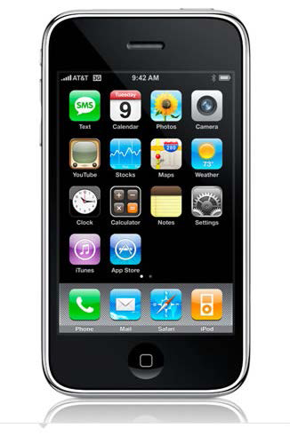
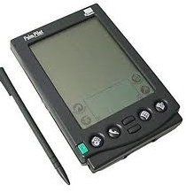
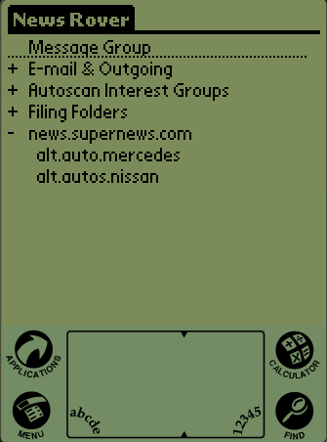
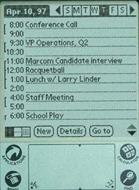
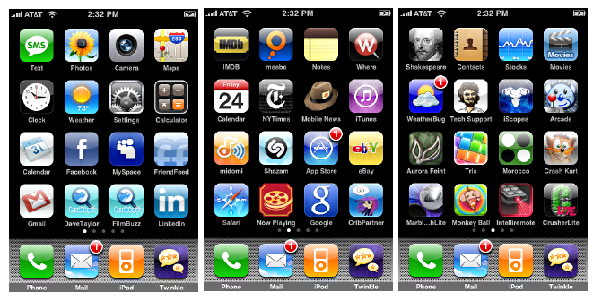
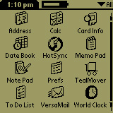
UX:Examples from real-life

Slide 5
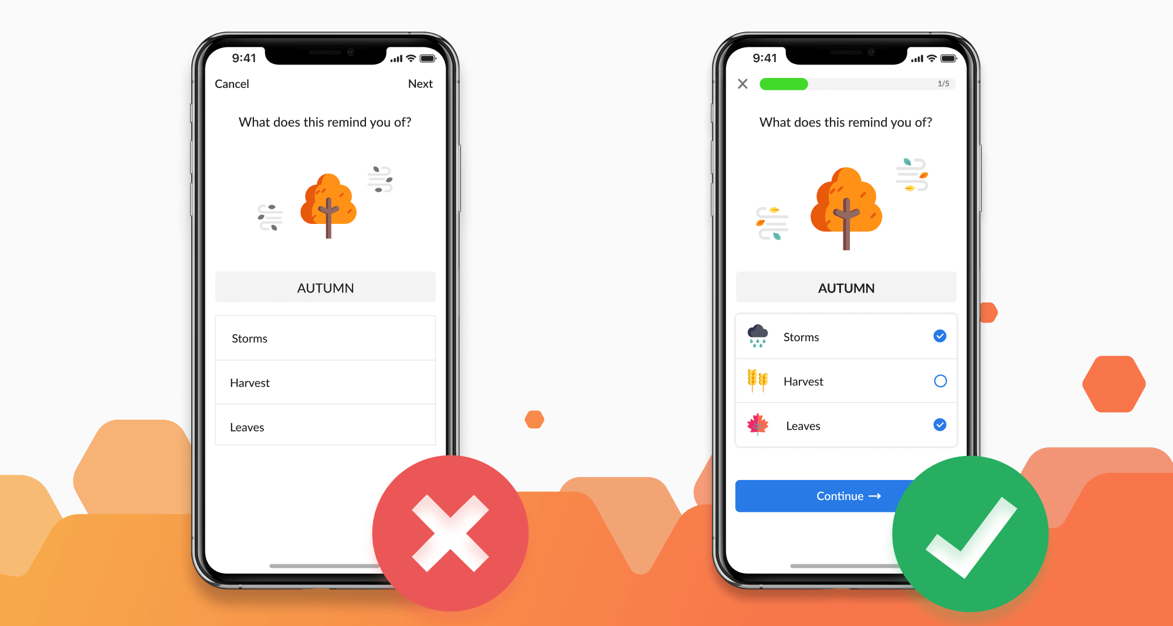

Slide 6
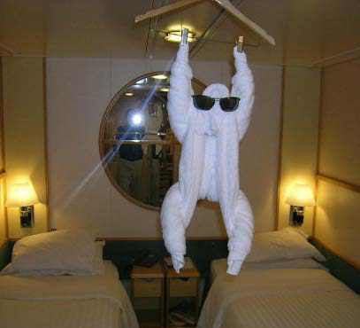
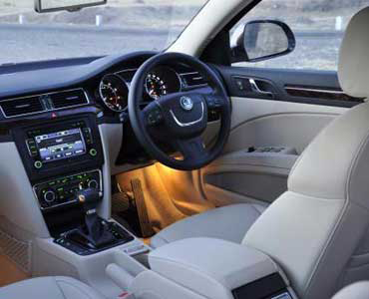

Some Good UX Examples

Slide 7
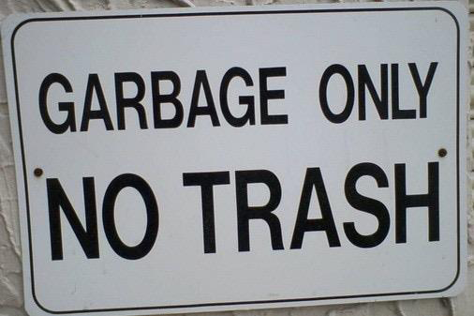
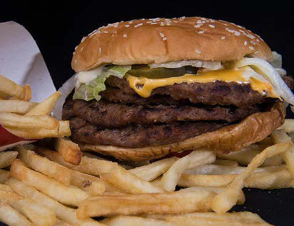
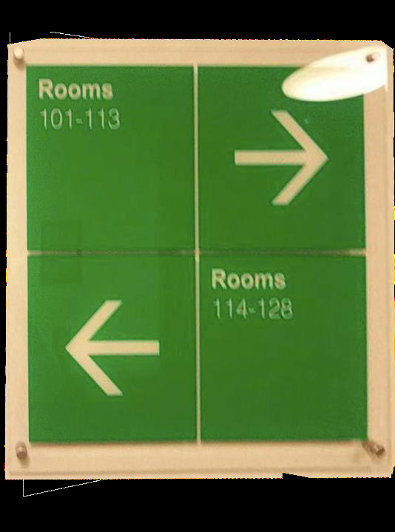
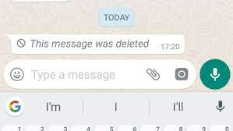
Some Bad UX Examples

Slide 8
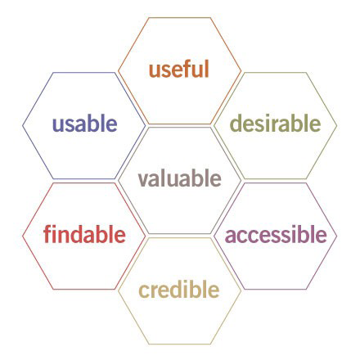
UX define your UX
Puts the end user at the center of the universe and defines the system from that perspective
7 Factors:
Usability is finding the best match between a user’s needs and a product’s use

Slide 9
UX define your UX
While this is a specialty by itself, a computer scientist/developer can grow an appreciation for UX, which affects
Functionality
System Organization and Structure
Interactions and Look and Feel
Access

Slide 10
UI
A user interface is the system by which people (users) interact with a machine.
The user interface includes hardware (physical) and software (logical) components.
User interfaces exist for various systems, and provide a means of:
Input- allowing the users to manipulate a system (i.e using it)
Output- allowing the system to indicate the effects of the users' manipulation

Slide 11
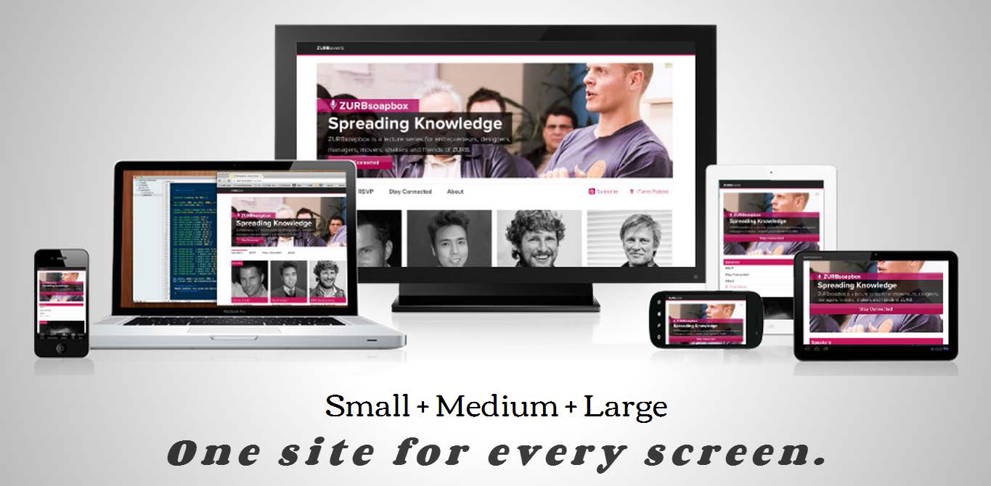
UI: Web vs. touch Responsiveness

Slide 12
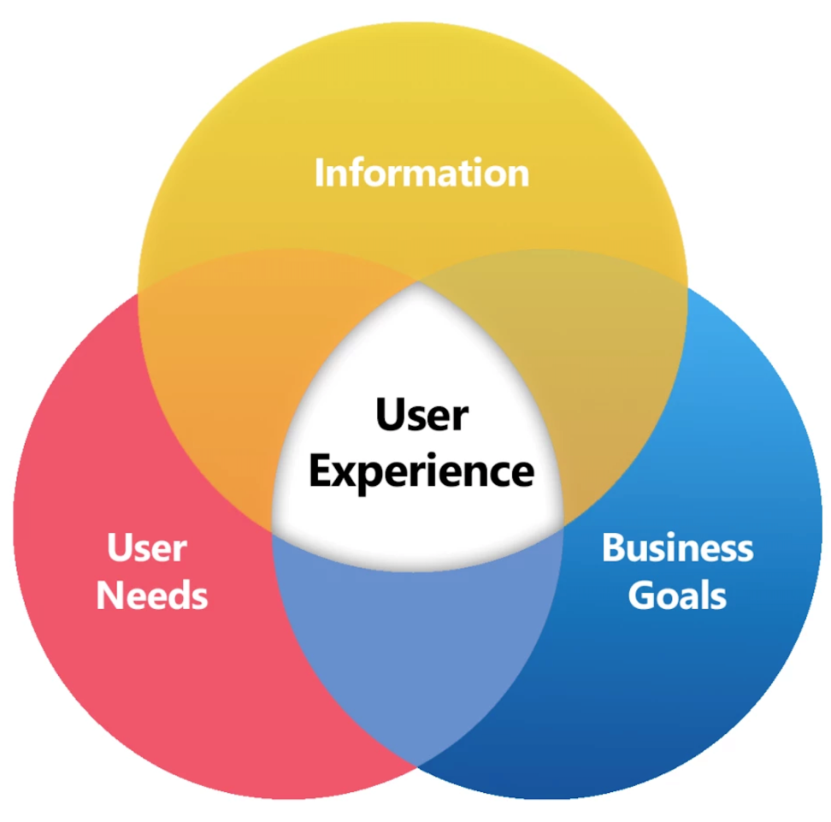
Relation Between UI and UX
UI fulfills two key UX needs:
Interactions and Look and Feel
Access

Slide 13
Where Do we Start? Define it
What is my product? (service, game, e-commerce, content…)
What do I offer? (something new, a new approach, cool twist…)
Who is my target audience? (teenagers, students, parents, men, women…)
What is my competitive advantage?
What do I want them to do? (action items/ 1-2-3, sign-up, buy, share…)
Hierarchy
Basic scenarios (“A person walks into a bar…”)
Simulate your design through your main features

Slide 14
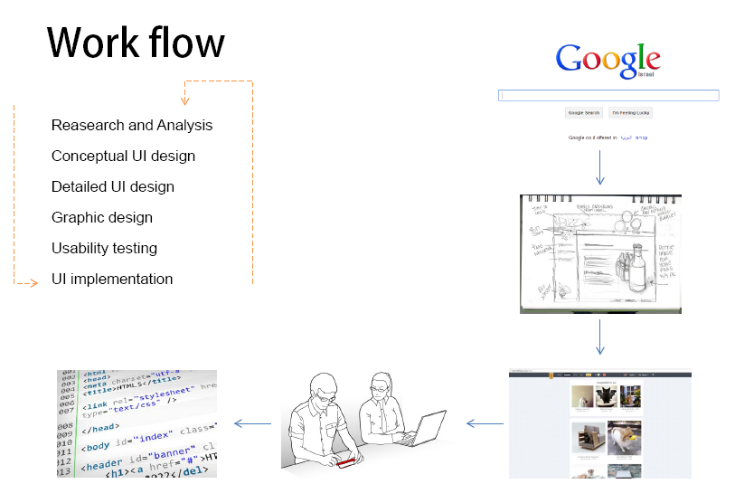

Slide 15
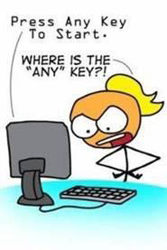
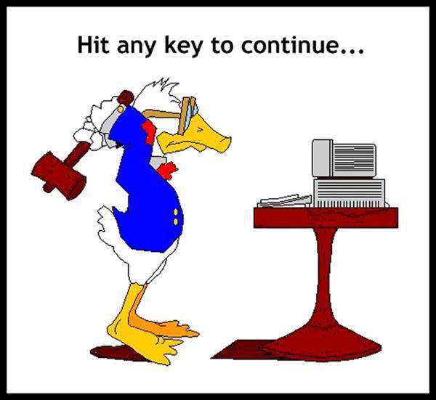
DESIGN IS HARD

Slide 16
WHAT IS A GOOD DESIGN?
A solution that serves the users and satisfies the client
Does what the users need and want
Natural to use
Helps them avoid trouble
Easy to say, very hard to do well

Slide 17
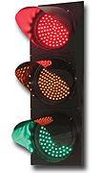
USER CENTERED DESIGN
Three simple Steps:
Identify who the users are
Identify what they want to accomplish
Constantly assess (1) and (2)
Is it a good design if ~10% of users can’t really use it easily?

Slide 18
HUMAN CAPABILITIES
Memory
Attention
Visual and Audio Perception
Learning
Language + Communication
Touch
Ergonomics (sense of fit)
VALUES & SENSIBILITIES
Level of experience
Physical or mental capabilities and limitations
Cultural expectations
Language differences
Senses of style
Have different needs or values
E.g., I want fast acceleration, but you want good fuel economy

Slide 19

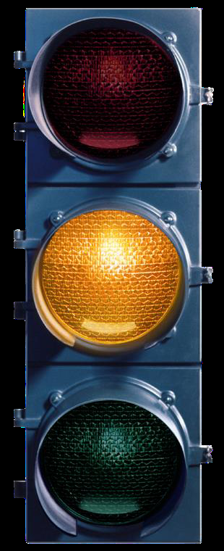
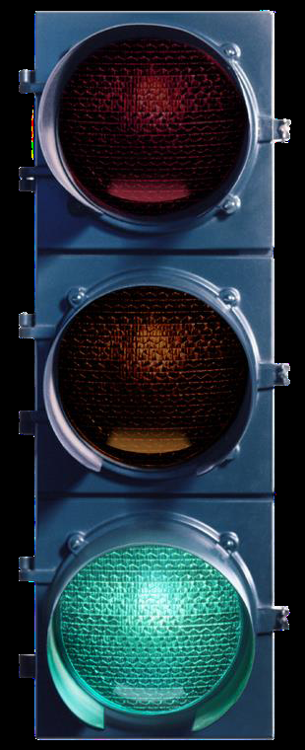
COLOR-BLIND PEOPLE USE OTHER CUES TO READ TRAFFIC LIGHTS

Slide 20
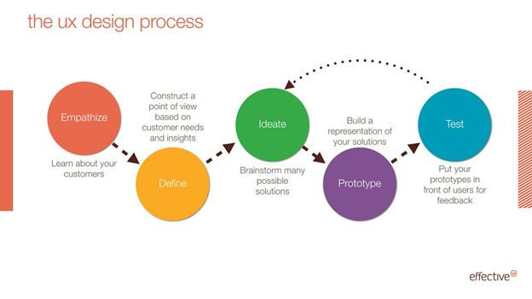
UX DESIGN PROCESS

Slide 21
The UX Life Cycle
Iterative, evaluation-centered, UX lifecycle
template to evolve UX design
Iteration:
All or part repeated for purpose of exploring, fixing, or refining design
Lifecycle is structured framework consisting
of a series of stages and corresponding
activities.
Template:
a skeleton of development activities instantiated within each project

Slide 22
Process Activities
• Analyze
– Contextual inquiry
– Contextual analysis
– Extracting requirements
– Synthesizing design-informing models
• Design
– Design thinking, ideation, and sketching
– Mental models and conceptual design
– Design production
• Prototype
– building prototypes
• Evaluate
– rapid and more rigorous techniques

Slide 23
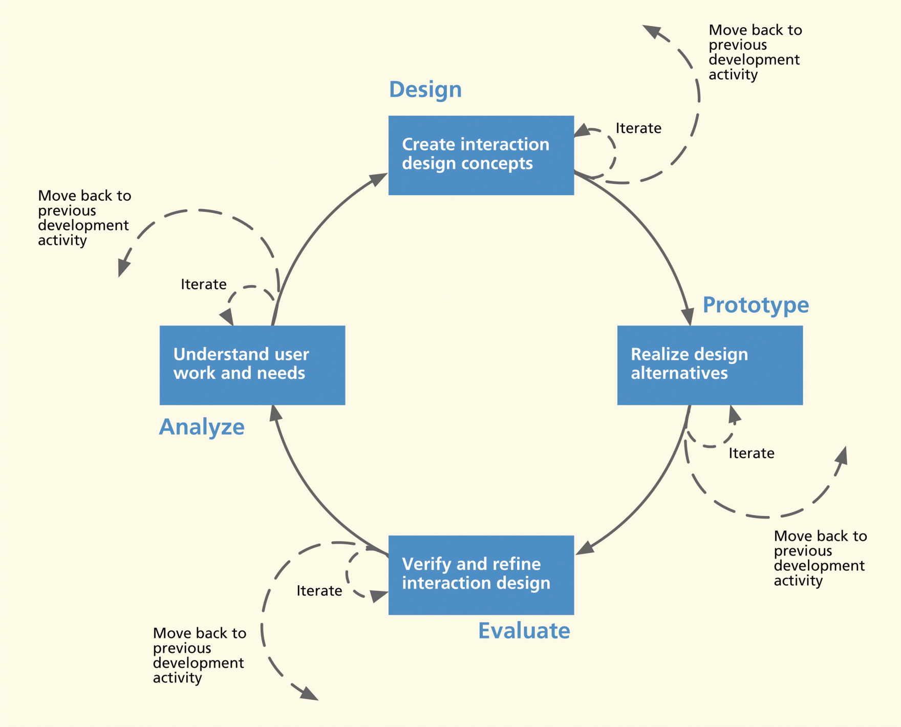
The UX Life Cycle A.K.A The Wheel

Slide 24
Navigating the Wheel
Activities can overlap, iterate
• Establish criteria for activity transitions
– When to leave?
– What to do next?
– When to iterate?
• Goal is to move into production
– Goals met?
– How much risk?
– Time and money?
– Problem complexity?

Slide 25
UX Techniques
Competitor Analysis
Performing an audit/review of competing websites and apps; conducting user testing of competing sites; writing a report that summarises the competitive landscape.
Analytics Review
Analysing web or mobile usage data, and making subsequent recommendations.
Stakeholder Interviews
Conversations with the key contacts in the client organisation funding, selling, or driving the product.

Slide 26
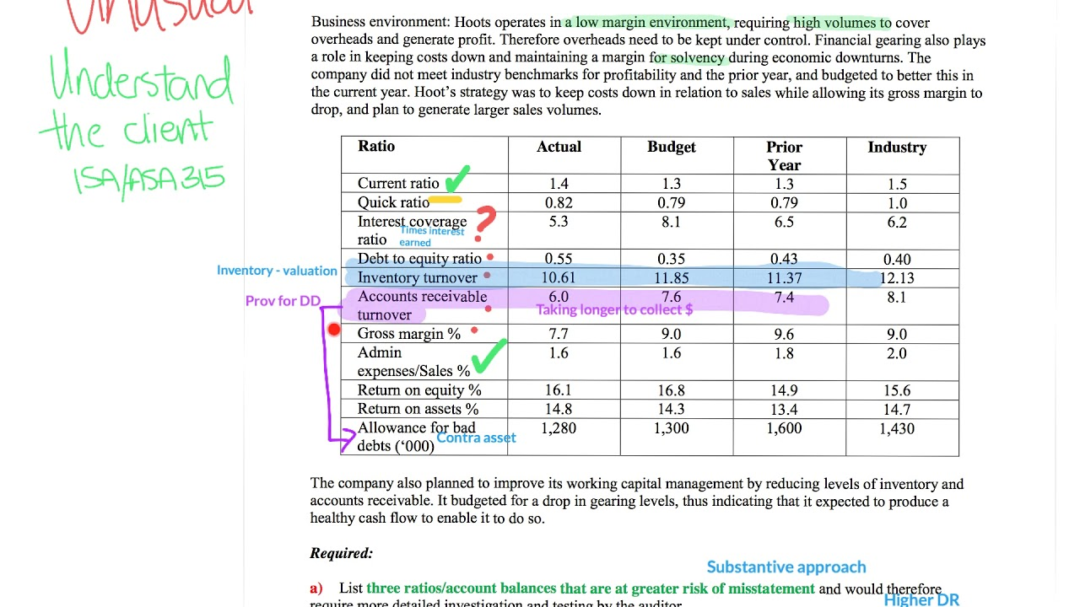

Analytical review
Stakeholder’s meet

Slide 27
UX Techniques
Contextual Enquiry
Interviewing users in the location that they use the website/app, to understand their tasks and challenges.
Surveys
Crafting an online survey, primarily to solicit feedback from current (or potential) users.
Content Audit
Reviewing and cataloguing a client’s existing repository of content.

Slide 28


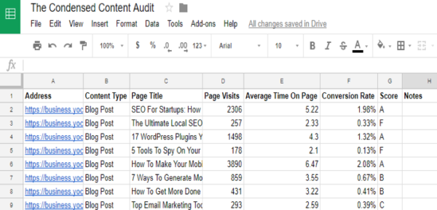
SURVEY
CONCEXTUAL ENQUIRY
CONTENT AUDIT

Slide 29
UX Techniques
Diary Study
Asking users to record their experiences and thoughts about a product or task in a journal over a set period of time.
User Interviews
User interviews are a key activity for understanding the tasks and motivations of the user group for whom you are designing. Interviews may be formally scheduled, or just informal chats (for instance, in a suitable location that your target demographic are present).

Slide 30
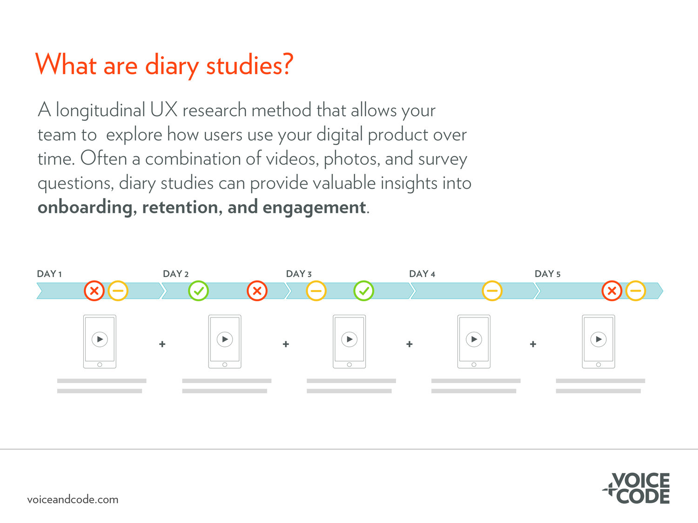

INTERVIEWS

Slide 31
UX Techniques
Heuristic Review
Evaluating a website or app and documenting usability flaws and other areas for improvement.
User Testing
Sitting users in front of your website or app and asking them to perform tasks, and to think out loud while doing so.
Unmoderated Remote Usability Test
URUT is similar to in-person usability testing however participants complete tasks in their own environment without a facilitator present. The tasks are pre-determined and are presented to the participant via an online testing platform.

Slide 32
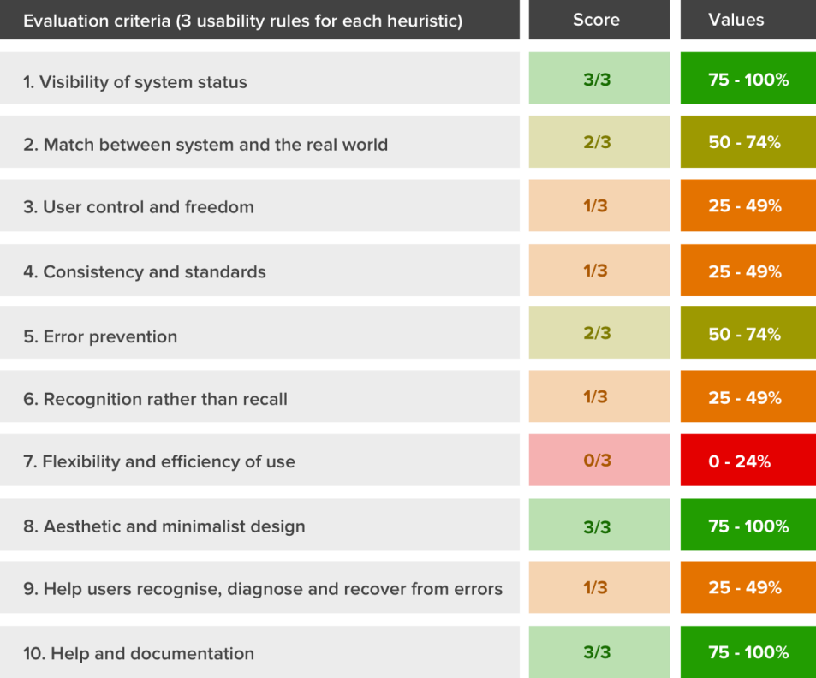
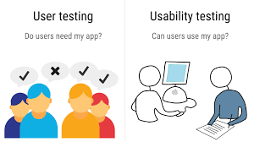
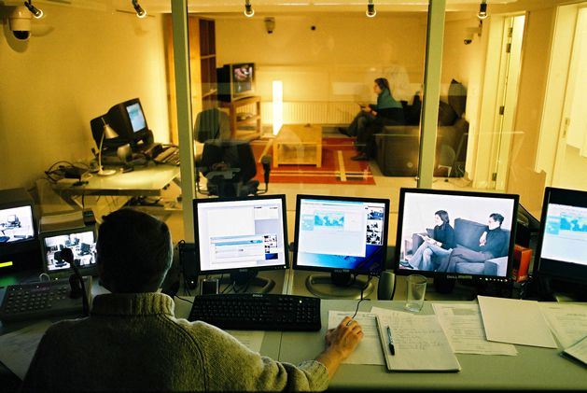
HUERISTIC REVIEW
USER TESTING
UNMODERATE REMOTE USABILITY TEST

Slide 33
UX Techniques
Use Cases
A use case is a list of steps that define the interactions between a user and a system. Use cases, especially when used as requirements for software development, are often constructed in UML, with defined actors and roles.
Storyboards
A storyboard is a tool inspired by the filmmaking industry, where a visual sequence of events is used to capture a user’s interactions with a product. Depending on the audience, it may be an extremely rough sketch, purely for crystallizing your own ideas.
Sometimes it can be useful to create a slightly more polished version of this a comic to communicate this sequence of events to key stakeholders in order to achieve buy-in for a concept.

Slide 34
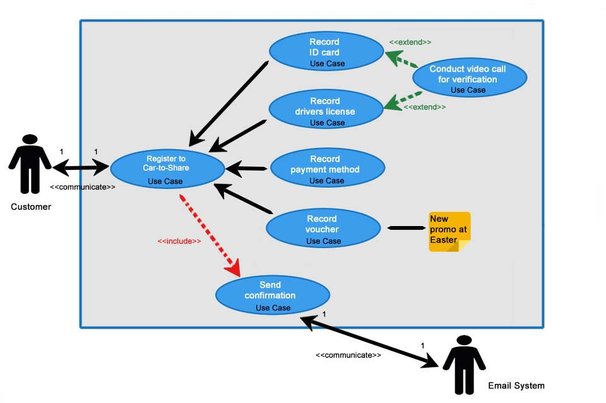
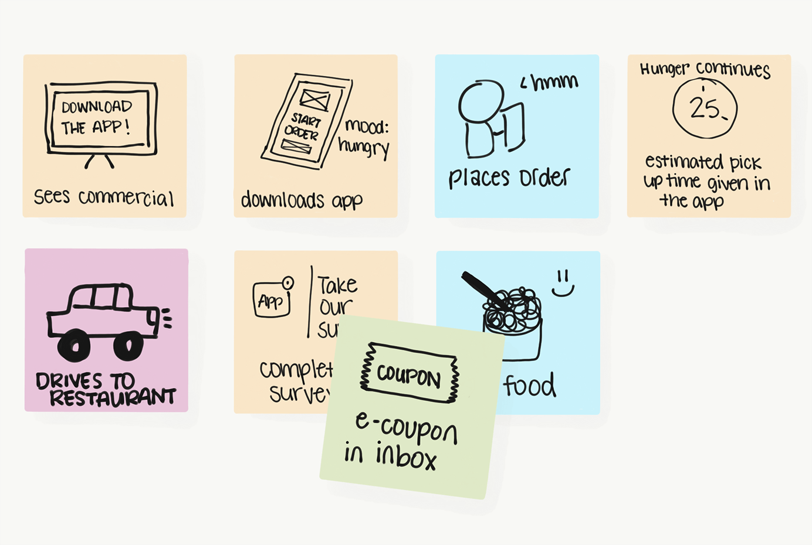
USE CASE
STORYBOARDS

Slide 35
UX Techniques
Affinity Diagramming
A business technique for identifying and grouping patterns within unrelated data.
Personas
A persona is a fictitious identity that reflects one of the user groups for who you are designing.
Scenarios
A scenario is a narrative describing a day in the life of  one of your personas, and probably includes how your website or app fits into their lives.

Slide 36
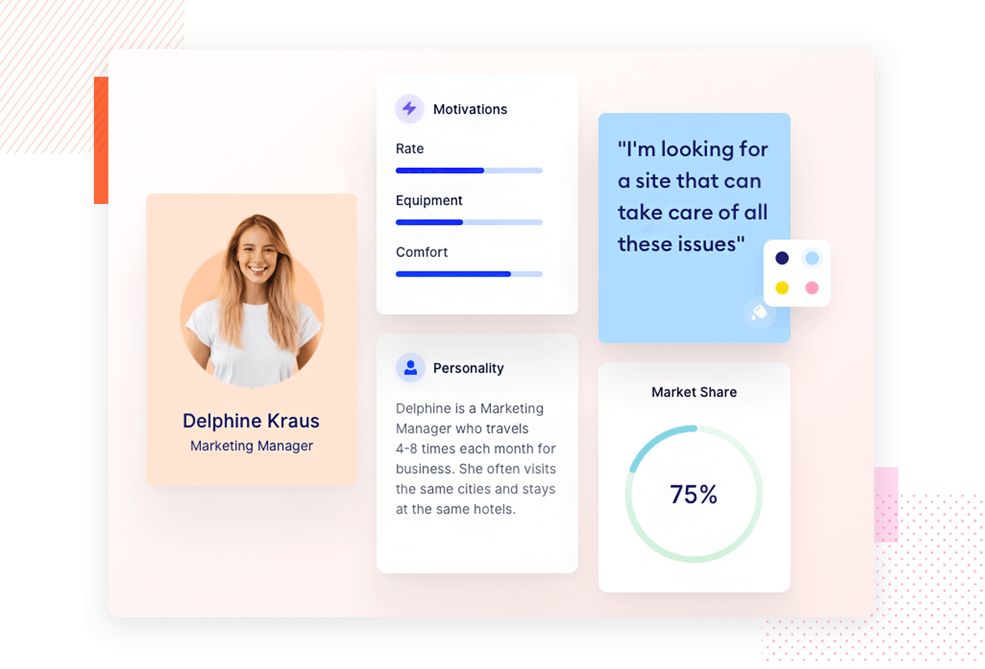
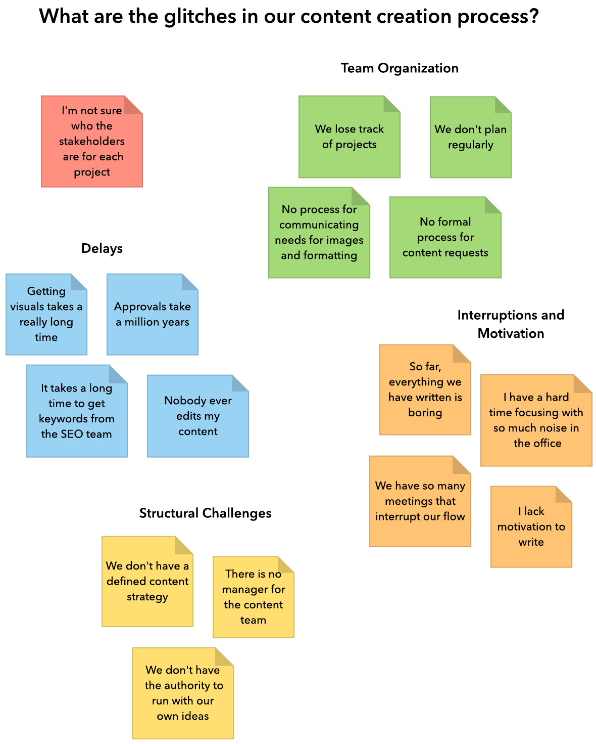
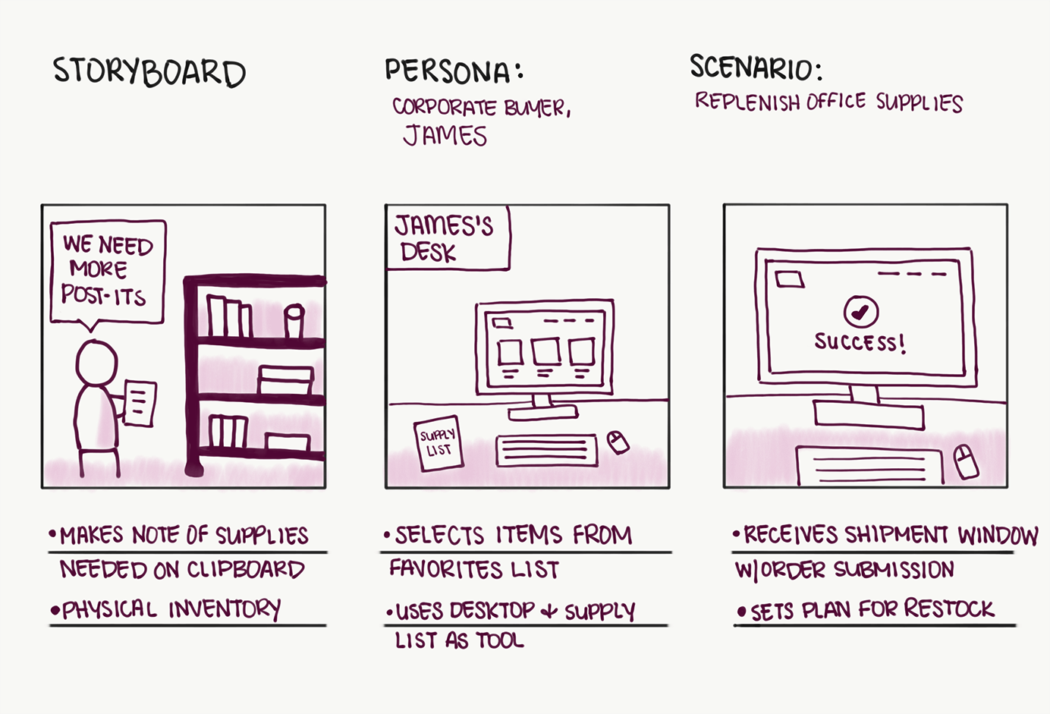
PERSONA
AFFIRNITY DIAGRAM
SCENARIO

Slide 37
UX Techniques
Mental Models
A mental model diagram is a fishbone or horizon diagram where the top towers represent individual’s motivations, emotions, and stories related to their experience in achieving a particular goal, regardless of the tools they use. The top part of the diagram is person-focused, not solution-focused. The bottom towers of the diagram represent the features of your organization's offerings, aligned beneath the appropriate upper towers that they support the best. You can see where your organization's design and business requirements support people's goals well and where they need improvement. The diagram as a whole is generative, not evaluative, helping your organization realize weaknesses and gaps in the way you support people and adapt existing products, services, or processes to particular behavioral audiences or situations.

Slide 38
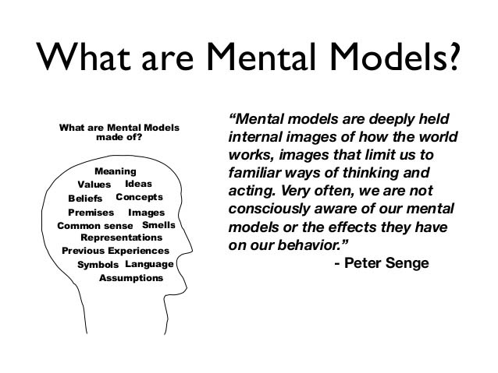

Slide 39
UX Techniques
Experience Map
An experience map, or customer journey map, is an extended version of a mental model. Rather than looking at one moment in time for a single user, an experience map is a wholistic, visual representation of your users' interactions with your organisation when zoomed right out.
Because many organisations and the projects within them are large and complex, an experience map is usually captured on a large canvas - a necessarily big poster that you can zoom in or out of to explore the details.

Slide 40
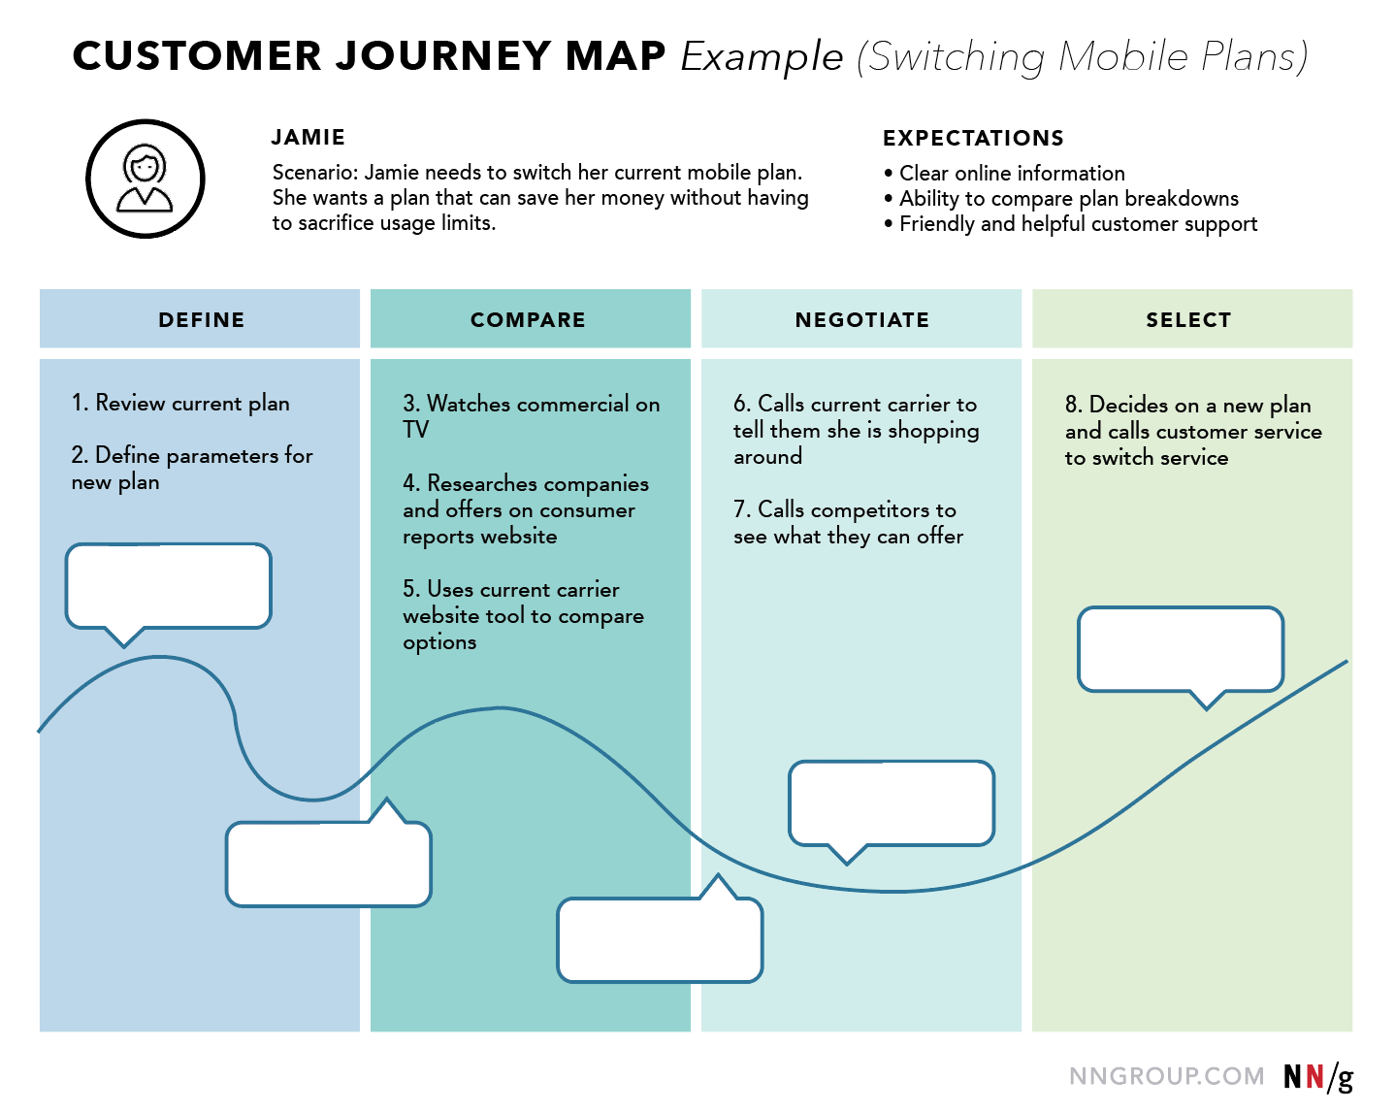

Slide 41
UX Techniques
Collaborative Design
Inviting input from users, stakeholders, and other project members.
Workflow Diagram
A workflow diagram (or activity diagram) is a graphical representation of activities and actions conducted by users of a system.
Sitemap
A sitemap is a complete list of all pages available on a website.

Slide 42
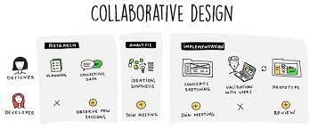
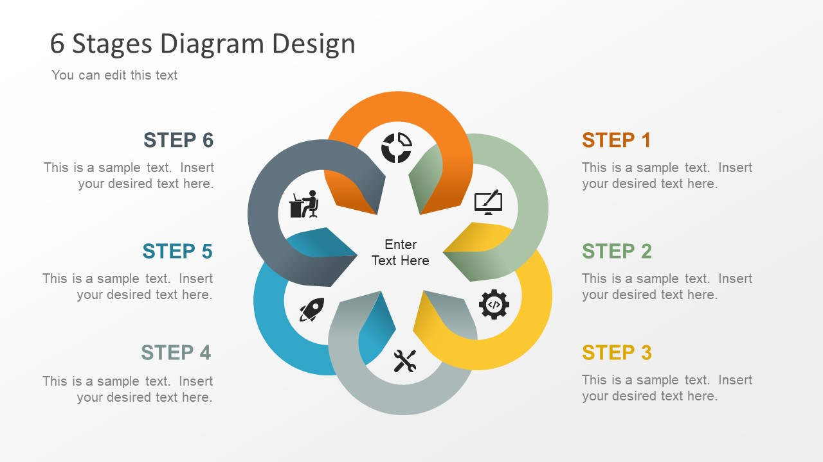
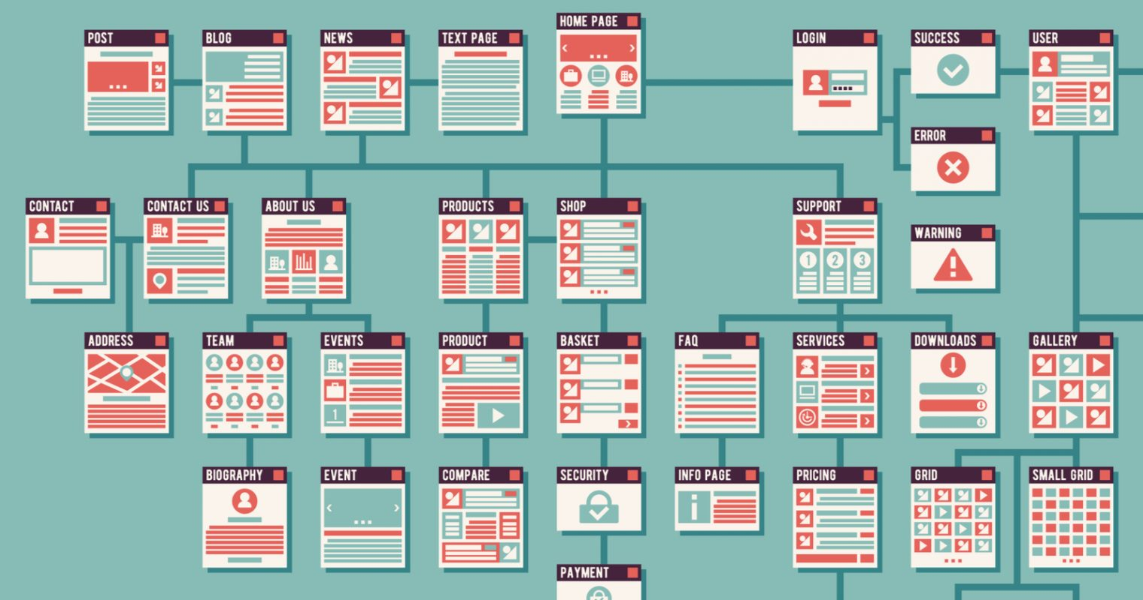

Slide 43
UX Techniques
Wireframe
A wireframe is a rough guide for the layout of a website or app. A prototype is similar in that while far from being a polished product in terms of visuals or functionality, it gives an indication of the direction that the product is heading. âMockupsâ is the term I use for wireframes that have been created in high fidelity, but for some people these three terms are interchangeable.
Card Sorting
Card sorting is a technique where users are asked to generate a folksonomy, or information hierarchy, which can then form the basis of an information architecture or website navigation menu

Slide 44
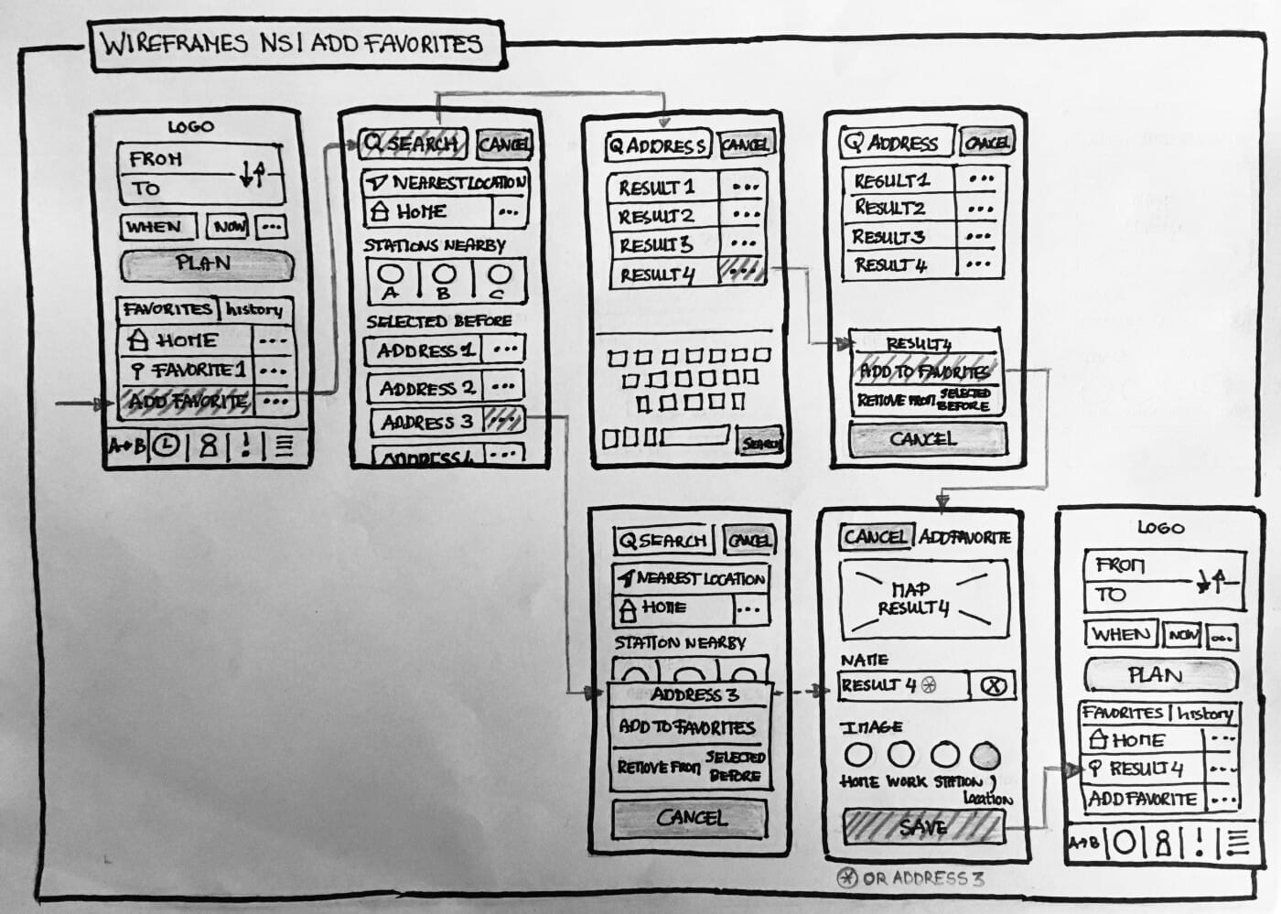
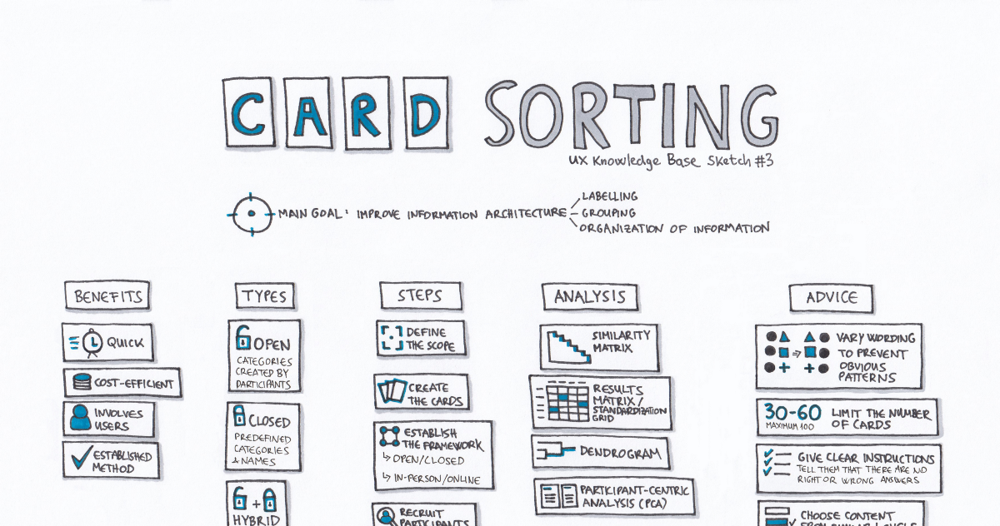

Slide 45
UX Techniques
Paper Prototype
Paper prototyping is the process of creating rough, often hand-sketched, drawings of a user interface, and using them in a usability test to gather feedback. Participants point to locations on the page that they would click, and screens are manually presented to the user based on the interactions they indicate.
A/B Testing
Good for testing new or experimental features before releasing them to all customers.

Slide 46
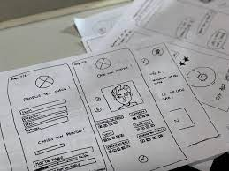
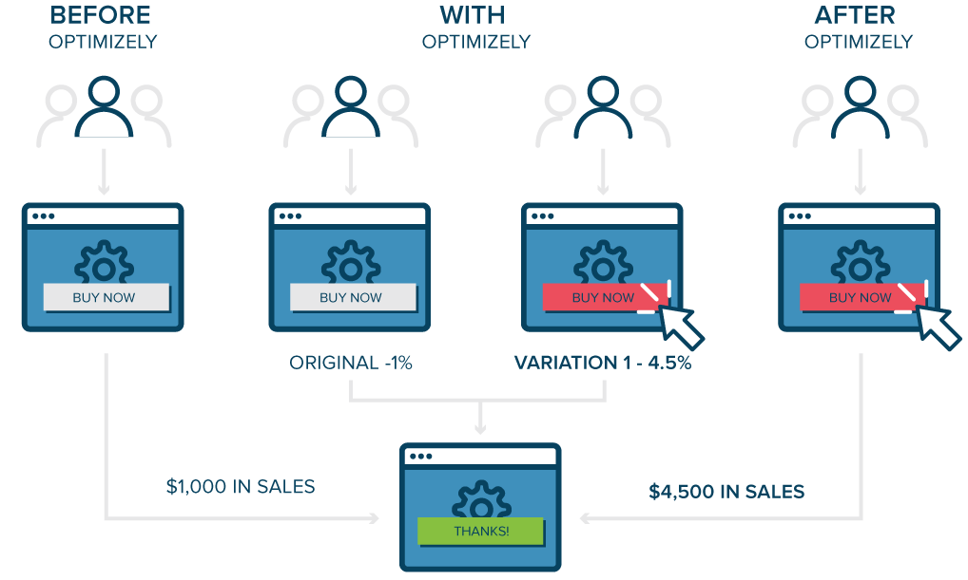

Slide 47
UX Techniques
Mood Board
A mood board is a collage, either physical or digital, which is intended to communicate the visual style a direction is heading (or should be heading). Stakeholders may use a mood board to provide a visual designer with the atmosphere they would like their site to convey and the colour palette to explore.
Beta Launch
Releasing a closed beta release of your product involves allowing only a select group of users to use the software and provide feedback before it becomes available to the wider public.

Slide 48
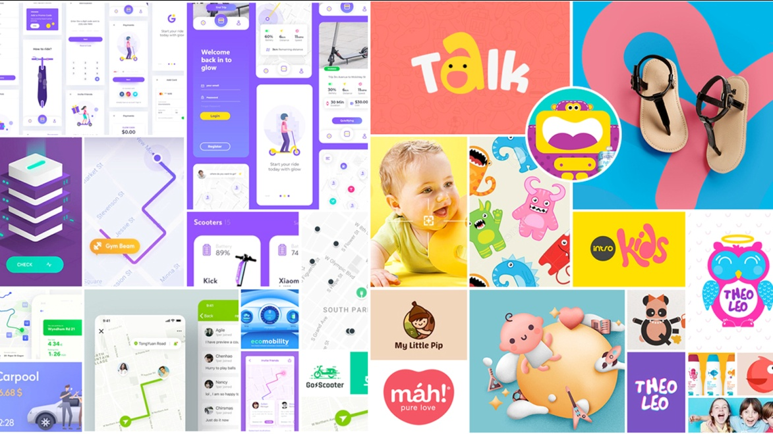
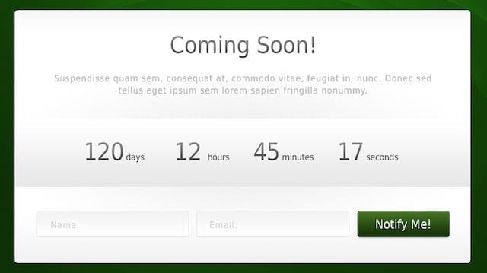

Slide 49
UX Techniques
business Case
A concise statement or document that facilitates business decisions by outlining relevant facts about market potential, idea validation, financials, risks, and links to business goals.
Competitive Analysis
An activity that involves listing direct rivals and evaluating their strengths, weaknesses and activity in the marketplace in comparison to your own.
Decision Matrix
A table or spreadsheet that lists various options and then tallies scores for each against range of weighted factors and characteristics. The highest scoring option indicates the best choice.

Slide 50
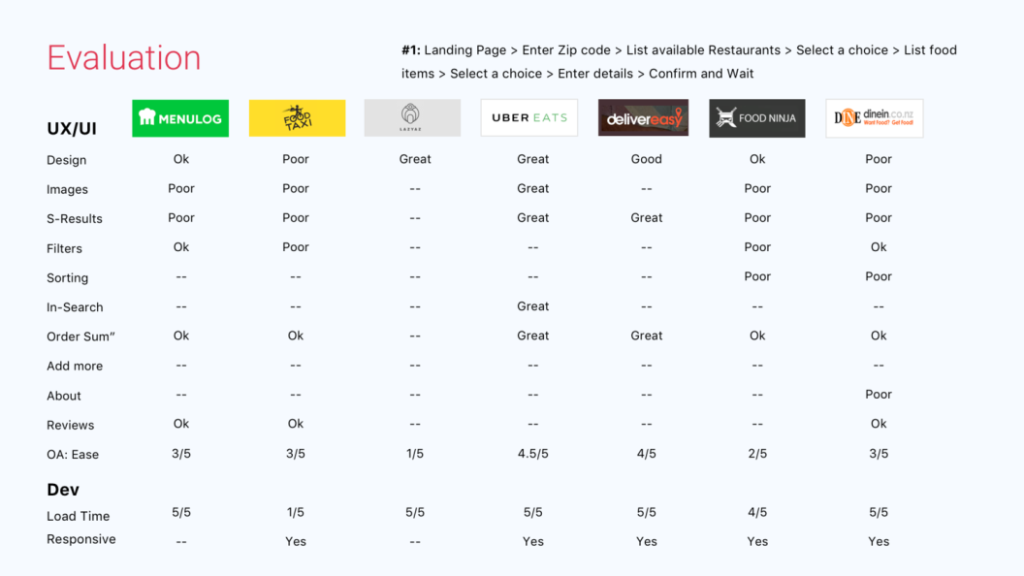
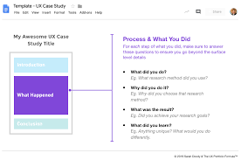
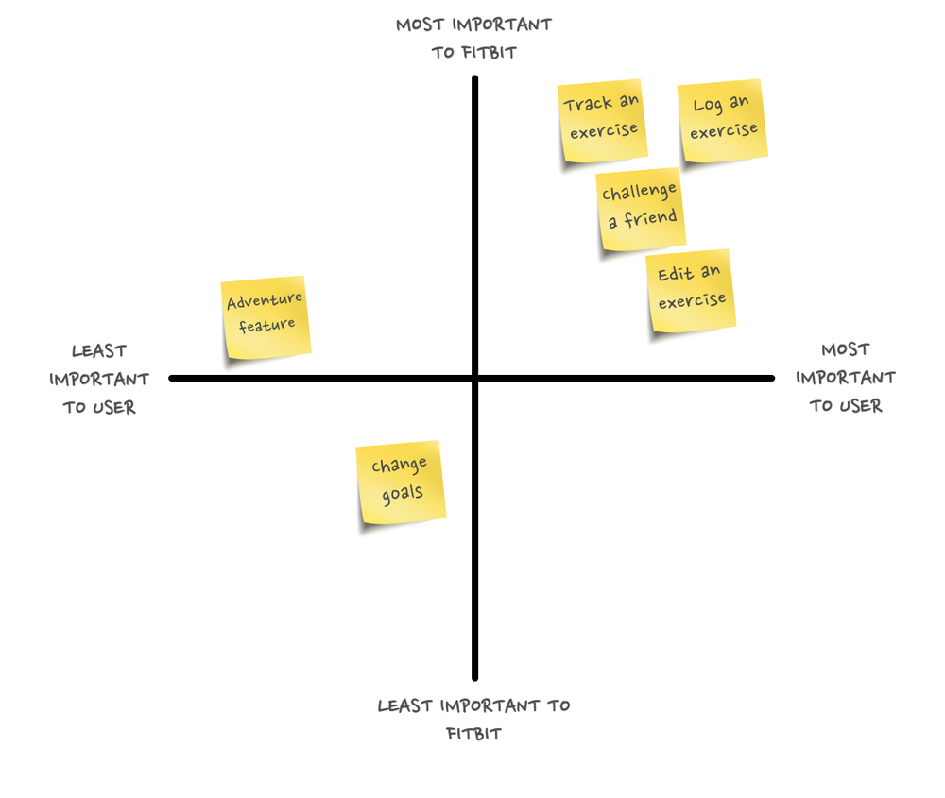

Slide 51
UX Techniques
Design Sprints
A process for answering critical business decisions using design thinking methods, generally conducted over a one-week period. It brings together a collaborative and interdisciplinary team to rapidly define, prototype and test new ideas with customers.
F-A-B Statement
An F-A-B Statement neatly connects a Feature, what it does (Advantage) and how its value Benefits the customer. This helps you clarify why a product or service is the most effective answer to customer needs.
Kanban
Kanban (Ôsignal cardÕ) is a lean method for visualising the progress of items through a workflow, often on a shared board with sticky notes placed in appropriate columns and lanes to show item status.

Slide 52
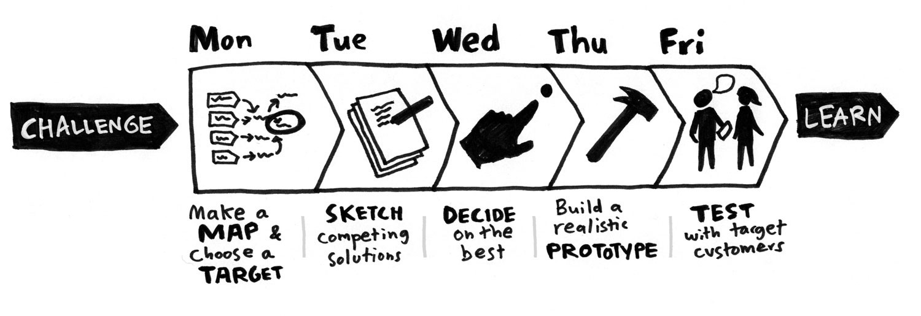



Slide 53
UX Techniques
Metrics Analysis
Interpreting patterns and meaningful insights within data to understand behaviour, activities and performance, in order to inform future experiments.
Product Roadmap
A flexible, high-level chart or diagram that maps out the vision and direction of your product offering over time, including how it evolves to deliver value to customers.
Product Scorecard
A snapshot document recording data for specific indicators about how well your product is performing across various important financial, customer, process and people metrics.

Slide 54




Slide 55
UX Techniques
Release Plan
A type of agile project plan derived from a product roadmap. It graphs how an individual project or major release is developed, usually by tracking burndown rate against a forecast.
Requirement Weighting Model
A type of decision matrix that removes politics and guesswork from finding a balance between the importance to customers and the cost & technical difficulty of development.
Stakeholder Mapping
A method for understanding stakeholders, often conducted as a 2x2 grid with axes for power/influence vs interest, or as a Venn diagram containing sets for power, legitimacy and urgency.

Slide 56
UX Techniques
SWOT Analysis
A structured planning method for evaluating helpful and harmful elements internally and externally to a venture, using sections for Strengths, Weaknesses, Opportunities and Threats.
User Stories
An informal, natural-language description of features in a software system, often captured on an index card or sticky note, and generally written by (or from the perspective of) an end user or customer.
Value Proposition Mapping
An activity derived from the Business Model Canvas that describes the features, benefits and experience of a product against the wants, needs and fears of a customer.

Slide 57
UX Techniques
Voice of the Customer
A detailed set of customer wants and needs organised into a hierarchy and prioritised in relative terms of importance & satisfaction with current alternatives. The information is sourced directly from interviews and enquiries conducted with customers.

Slide 58
Ux scope
Scope is the place where we translate user needs and business objectives into specific requirements for what content and functionality the product will offer to users.
Scoping is about creating the sandbox within which the UX designer will work, defining the problem that is being solved, and the measures of success. Clear scope upfront will lead to better outcomes at the end of the work.

Slide 59
Defining Project Scope
“There are essentially two ways of defining scope,” You can define project scope based on:
Best practices—In the project-management world, people generally refer to taking this approach as a time-and-materials project. Such projects have a specific goal such as: create a Web site.
User Experience is an important component of building a Web site, but the term User Experience can cover a multitude of different processes and deliverables.

Slide 60
SCOPE
An allocated budget
This is what we call a fixed-budget project. In such cases, you’ll likely receive a budget that stakeholders have allocated to the UX-design portion of the project.

Slide 61
SCOPE: Key Points
Know what we are building
It gives a clear description about what we are building, and how it related to our goals. and Yes, we can’t define a scope with 100%, and say this is exactly what is going to be, because new things are going to come during the project, but, if we defined boundaries of what you can and can’t do in the Scope, it will be much easier.
Address conflicts
Defining scope makes us to address potential conflicts, and the bottlenecks from implementing the features before design and development.

Slide 62
SCOPE
Reference point
Defining scope gives a reference point for client and developers about the work that’s going to be done. Documentation of the Scope doesn’t have to be a novel, but a common understanding of the features, schedules, and milestones puts everybody on the same page, and gives them a common reference.
Explore connections
Defining scope gives enables you to see connections between individual requirements that wasn’t clear, and organize related requirements, which may help then in determining which structure is appropriate for your product.

Slide 63
SCOPE
Assign Responsibility
Having a defined set of requirements allows you to assign responsibility for the work, so no body will have a conflict about who is responsible for what tasks.
Keep track of new features
More features are coming during the project. Because there is information coming to the light and So, suggested changes or new features should also be documented.

Slide 64
SCOPE
What to tackle now and what has to wait
Having a list with set of features to be implemented can help in determine which features can be done now and which has to wait until the next iteration.

Slide 65
Functional and Content Requirements
We start by generating the requirements, negotiate, prioritize and finally we document the requirements.
Generating Requirements
Some requirements apply to the product as a whole, such as supported browsers and operating systems, while other requirements apply only to a specific feature. The level of detail in your requirements will often depend on the specific scope of the project.

Slide 66
Functional and Content Requirements
Things people say they want
Either people try to remember their past use for the product, or speculate about their future use. And the problem is, people make false predictions about their future behavior, especially when presented with something that’s new and unfamiliar.
Things people aren’t actually want
Sometimes the things people say they want are not the things they actually want, because when people have troubles with a process or a product, they try to imagine a solution, but not all solutions are feasible.
Things people don’t know they want
When people talk, they may hit upon great ideas that nobody said before. These ideas often come from brainstorming sessions.

Slide 67
Generating Requirements Takeaways
Requirements can’t be gathered
Requirements can’t be gathered, requirements have to be generated, and created through discussion with users and all stakeholders.
Clients won’t give all requirements
They won’t give all necessary requirements, because they don’t have it, so part of your job is to collaborate with them to generate that requirement.
Functional Specification
It’s the requirements about the functions, or features in the product, how features work with each other, and how they interrelate with each other.

Slide 68
Generating Requirements Takeaways
Requirements shouldn’t be based on opinions or preferences
Much of what provided in requirements will be based on personal opinions or preferences. Even if it’s applicable, it doesn’t mean it’s the right thing to do.
Observe users behavior
Because what people say they want is not always what they really want, and what they say about what they do, is not always what they really do. So, we need to observe their behavior in their daily life, this will give us information about what we need to do a lot more than through discussion and guessing.

Slide 69
Generating Requirements Takeaways
You duty shouldn’t be to take orders
Designers, developers, project managers are here because they have a degree of expertise and knowledge.
So, it’s our job to apply our experience and knowledge to figure out what the requirements should be. This will help the clients to get the right solution and achieve the user or business goals.
Focus on the need, not the solution
Strategy are needs, features are solutions. Needs are often combined with solutions because people often communicate their need by suggesting solutions instead of saying their actual need.
So, focus on the need first then come up with solutions through discussions, because you can’t know if a feature is relevant, appropriate or valuable until you know the actual need for that feature.

Slide 70
Generating Requirements Takeaways
Requirements Negotiation
During generating the requirements, we negotiate. The aim of negotiation is to let everybody to say what he think it’s important to be considered, resolve conflicts, and deices on the requirements that will be documented.
The best approach to resolving a conflict between stakeholders is to engage, and look back to the defined Strategy.
Requirements Specification
Requirement Specification is divided into features and content.
With no-documented requirements it will be a mess, as everybody needs to have the same understanding about the product, and what we are going to build.

Slide 71
Generating Requirements Takeaways
Requirements Prioritization
During, or after generating the requirements, we prioritize.
Sometimes one requirement can be applied to accomplish multiple strategic objectives, and also one objective will often be associated with several different requirements.
Does the requirement fulfill a user need
Does the requirement fulfill a business goal
How feasible is the requirement, can we design, build and test it under current time constrains, resources and budget.
Are there any potential conflicts

Slide 72
Generating Requirements Takeaways
Content Specification
Content refers to text, images, audio, and video, and different content types can work together to fulfill a single requirement, like having an article with text and images.

Slide 73
Writing effective requirements
Be positive
Instead of describing a bad thing the system shouldn’t do, describe what it will do to prevent that bad thing. As an example, negative statement: “the system won’t allow the user to do X without Y”, while positive statement: “the system will ask the user to do Y if he tries to do X”.
Be specific
Requirements should be clearly defined. As an example, not specific statement: “the system will display the most popular movies”, while the specific statement: “the system will display videos sorted by the most views”.

Slide 74
Writing effective requirements
Don’t be subjective
Subjective keywords means keywords based on or influenced by personal feelings and definition.
As an example, subjective statement: “the site is be cool”, while the non-subjective statement: “the site will have looking according to the company guidelines”.

Slide 75
Things to consider when dealing with Content
Content Source
The process of generating content requirements starts with identifying and validating content sources.
Identifying the content source will allow you to identify the inappropriate content, like when the content coming from a source, people don’t care about, or it’s no longer true.
The resources needed
Identifying all the content types associated with a feature can help you determine what resources will be needed to produce the content.

Slide 76
Things to consider when dealing with Content
Content format and purpose
Content format is what you want to build(i.e. FAQ), and it’s purpose, which is easily access to commonly asked questions.
When the focus is on the format, the purpose can be forgotten, like when users ask you to make an FAQ, and they forget about why it’s here in the first place, that’s why user may go to the FAQ and it doesn’t really help him to do anything.
The size of content
What is the size of each feature, like word count, dimensions of images, are there multiple sizes of images, what’s the bandwidth for images and videos for streaming.

Slide 77
Things to consider when dealing with Content
Who is responsible for what
Who’s responsible for writing articles, taking & editing photos, audio and video, and where we will store them.
Content should support user and business goals
Is the content relevant to the reason that people have to come & interact with out product, Is it aligned with and support the overall goals and needs.
Content should appropriate
Is it appropriate for target audience, and representing who we are, and what believe in, what we offer.

Slide 78
Things to consider when dealing with Content
The degree of relevance and appropriateness depends on:
Method of delivery: is the content just text, animation, audio and video, or combination of those.
Style and structure: is the style consistent with the message we want to deliver, and for the structure, what’s the way the content is organized, categorized, prioritized, …etc.
Substance: is the information is valuable, meaningful to the users.

Slide 79
Things to consider when dealing with Content
Content should be contextual
People are going to be in a specific context while interacting with out product. So, there are some considerations to be taken into account:
Physical: What’s the user is doing, or activities while interacting with the product
Emotional: How is the person feeling while using the product
Cognitive: What’s the mental ability required to learn about the website
These considerations influence how users absorb and perceive the content.

Slide 80
Things to consider when dealing with Content
Content should be user-centered
Content should revolve around the user perspective. So, does the content …
Reflect what the user care about most, versus what the organization care about most.
Match our abbreviations with the terms and phrases users usually think about, versus using acronym and abbreviations of the company.
Focusing more why does this product matter, valuable, for the user, versus Content is all about us, there is nothing to say what’s in here for the users.

Slide 81
Symptoms of not properly defined scope
Slipping deadlines
When you miss a deadline, one after another, that’s the sign of bigger things are going to happen, and you are in troubles.
Too many questions
When people involved in the project are confused, and asking many question, like if they can do or add something(i.e. feature) or not, this is a sign that those people have no clue about what the Scope is, and they don’t have a clear vision for what they are trying to accomplish.

Slide 82
Symptoms of not properly defined scope
Unimpressive release
When you make a release, and it doesn’t seem that you made a remarkable impact & valuable features, so there isn’t much progress you made. This is usually because the Scope is too small.
Unrealistic expectations
When you will be expected to deliver many features by the next week for example, and there is no way you can do it. This is usually because the Scope is too big.

Slide 83
Symptoms of not properly defined scope
Avoid scope creep
Scope creep means when additional features, ideas, are not only keep coming up, but, they don’t seem like much extra work.
Trade offs
Trade offs are the possible choices we have. Identifying trade offs, comparing between them and which choice is critical to the value we provide, and the business needs can have an impact on the overall outcome.

Slide 84
Ux Rigor
Rigor is the only Digital Experience Monitoring (DEM) solution designed to find, fix and prevent web performance defects to improve the user experiences that drive revenue for the enterprise.
Rigor’s cloud-based and on-premise user monitoring and innovative website performance optimization capabilities combine to enable fast and reliable deployment of digital applications and websites that improve agility, efficiency and confidence.

Slide 85
UX rigor
Rigor means knowing how to screen for participants who are real users, how to ask questions that don’t lead participants; and how to respond to questions in an unbiased, non-committal way when engaging with users.
Rigor also means knowing which tool in your toolkit to recommend to answer the type of research questions you need to answer.
One size does not fit all.

Slide 86
Five tips to improve the rigor of your UX surveys
1. Never-Should-You-Ever… Serve mains before appetizers
Warm-up your respondent with general ‘positioning’ questions, then lead into more comprehensive inquiries. Asking age and gender straight away can irk your participants.
Crosscheck demographic questions for necessity, unless they will directly impact your design, don’t ask what you don’t need to know.

Slide 87


Slide 88

2.Never-Should-You-Ever… Trap your respondents

Slide 89
2.Never-Should-You-Ever… Trap your respondents
The number one reason people drop out of surveys is when their question response isn’t included in the options (1,5). Frequent culprits are questions without the choice of ‘Not Applicable’ or ‘None of the Above’.
These ‘non-exhaustive’ questions trap respondents into an answer that might not correctly capture their experience. Not only will they generate false data, but non-exhaustive questions also influence respondents to exit the survey before completion.

Slide 90
3. Never-Should-You-Ever… IUBWA (Include Unnecessary Big Words and Acronyms)
Unnecessary big words are a fool-proof way to ostracize your audience. Lose the lingo, stick to simple language, and avoid acronyms.
In his excellent book, Questionnaire Design, Ian Brace stresses the importance of reducing technical language and keeping questions to 10–12 words if possible (1).

Slide 91


Slide 92
4. Never-Should-You-Ever… Describe something, when you can show it
Avoid describing features. Instead, include visuals to communicate your question in an understandable way. Never underestimate the power of an image to present variable layout options, or color variations.
Even if it’s a simple query, providing an image will facilitate engagement and possibly trigger a more accurate memory of the process/product/interface for your participant. A better-prepared respondent will equip you with better quality data.

Slide 94
5. Never-Should-You-Ever… Ask a double-barreled question
You’ve probably heard about double-barreled questions, they refer to asking more than one question at a time.
This can happen when people consolidate questions and chunk information they mistakenly view as similar.
For example: “How do you rate the experience of adding comments and photos for App X?” When it comes time to analyze the survey, you won’t be able to separate the data, someone could have a positive experience for one feature but a negative experience for another.
To generate qualified statistics, inquire on one topic per question.

Slide 95


Slide 96
complexity and Project perspective
The complexity of a design process or a design artifact substantially influences their performance. ... The functional definition states that a design complexity is a function of its probability of successfully achieving the required specifications (functional requirements and constraints)
There are two types of complexity. We talk about objective complexity or technical complexity, when we can measure it.

Slide 97
Types
There are two types of complexity.
We talk about objective complexity or technical complexity, when we can measure it.
The more relationships and dependencies occur, the more complex a system becomes.
Engineers are tackled day by day to manage complex systems, mostly the ones they have built by themselves.

Slide 98


Slide 99
Here are some more scenarios where you might encounter iceberg-related drama:
The project hasn’t been scoped properly — In the agency world, this happens a lot when someone sells and scopes a project without UX practitioner supervision. Once a practitioner comes on board, they spend the first 2 weeks furiously trying to get everyone to realise that the client’s expectations are actually much greater than the time and resource assigned.
Over-promising without technical understanding — Again, a classic agency or consultancy trait. With the desperate desire to please a client comes the promising of All The Things, or even one “simple” thing that turns out will take years and cost billions.

Slide 100
Here are some more scenarios where you might encounter iceberg-related drama:
Someone made a pretty — The obsessive desire of some stakeholder or even designers to rush to screen designs results in everyone believing something already has been thought-through, is based on evidence of user need or behavior, has consensus behind it, is usable, accessible profitable, buildable, or even… finished and live.
Too many assumptions — Humans like to think they know things. See above. So they assume things based on a combination of past experience and how they want the world to be. Asking questions removes risk. Forging ahead with only assumptions will result in iceberg impact.

Slide 101
Subjective complexity
We encounter subjective complexity when we master a musical instrument. Let’s take a look at playing a Chopin piece on the piano.
For a beginner, reading sheet music is complex. Playing them in the appropriate rhythm, harmony and later on with two hands is difficult. Is playing the piano a complex task? Yes, it is, at least for the beginner. For somebody with years of experience that is not the case anymore.
Enterprise organizations and software for professionals are also complex. We need to understand our perception of complexity and how to manage it.

Slide 102
Complex vs Complicated
People have the desire to make things simple. Which is good, because things can be unnecessarily complicated at times.
Complicated is usually the term of how we react to complexity when we don’t understand it.
A bus schedule with no regular intervals is complicated.
A software that does not follow interaction standards is complicated. Often products are extended with features that sell well, but make usage more complicated. Do we need a water kettle with a WIFI-module so my mobile app can display the water temperature? Simply not.

Slide 103
Complex vs Complicated
This principle which applies to science applies to product design as well. The most interesting part in Einstein’s quote are the last three words “but no simpler”. Simplification is necessary. But there is a point, simplification reaches a limit. The limit is an unavoidable complexity. It can show up in two areas:
1. Users work with products and produce complex work (think about 3D animation, CAD models or process automation) 2. Products by themselves cover plenty of features and are complex to use

Slide 104


Slide 105
Designing complex systems
Once we recognize and remove unnecessary complicated elements, we can use methods to handle unavoidable complexity.
These are mental models, structure, just-in-time knowledge, shortcuts, motivation (when the brain produces dopamine) and filtering.

Slide 106
Complexity is part of every business
Face it. Complexity shouldn’t discourage us, rather, we should see the opportunity.
It can be rich and rewarding where simplicity is boring.
What matters to product design, matters to life. Tackle complexity and make it understandable.

